Slide 1




ME Program Hunter Region NSW & STEM Opportunities The University of Newcastle Tuesday 19th July 2016 Dr Scott Sleap
Notes:
The main purpose of this presentation is to discuss ‘what is STEM?
In addition I will discuss the ME Program for which I am its Director and
We will experience STEM through a simple exercise.
However, the answer to what is STEM is clearly summarised in your school motto ‘Explore, Dream & Discover’
ME Program Director Regional Development Australia – Hunter
TAS teacher with 20 Years Experience, HSC level experience in DAT, SDD, IPT & Engineering Studies
Head Teacher, Teaching and Learning, & Industrial Arts, at Maitland Grossmann High School 14 years
Completed a PhD in Engineering at The University of Newcastle 2015
Passionate advocate of STEM education and the opportunities it provides

Slide 2


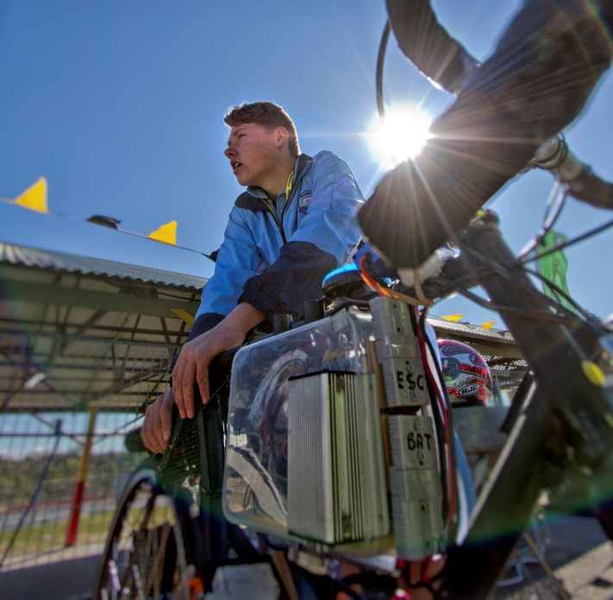
RDA – HUNTER’S ME PROGRAM
2016 ME PROGRAM
STEM Skilling Program
Targeted at secondary High School Students
Help Build Careers in STEM
Students to discover the joy and the purpose of STEM subjects
Contextualising experiences that are relevant and real world in nature
Notes:
The ME Program is a regionally focused STEM Skilling initiative funded by the Department of Defence and managed by Regional Development Australia – Hunter
The Program provides high school students from Year’s 7 - 12 with educational pathways and engaging experiences required to assist them to build a career in STEM
It seeks to provide an environment for students to discover the joy and the purpose of STEM subjects by contextualising experiences so they are relevant and real world in nature

Slide 3
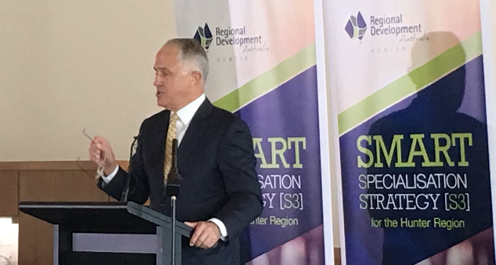




PROGRAM UPDATE
2016 ME PROGRAM HIGHLIGTHS - National
Prime Minister Turnbull Launches RDA Hunter’s Smart Specialisation
National Innovation & Science Agenda (NISA)
National STEM Programme Index
Notes:
Some of the highlights of the ME Program in 2016 are;
The Prime Minister Malcolm Turnbull Launching RDA Hunter’s Smart Specialisation, where the ME Program’s STEM Skilling program was highlighted
The ME Program being recognised in the National Innovation & Science Agenda (NISA) as an exemplar.
Specifically ‘Recognised for linking industry needs with schools and tertiary institutions leading to increased STEM participation’
A number of ME Program STEM initiatives were included in the first National STEM Programme Index compiled by AI Group and the Australian Governments Office of the Chief Scientist

Slide 4

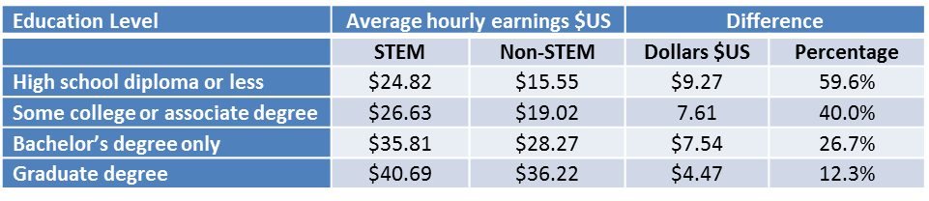
WHY IS STEM NEEDED?
75% of the fastest growing occupations require STEM skills and knowledge
People with STEM qualifications are more likely to be employed than those with non-STEM qualifications at the same level
Workers in STEM occupations also earn more on average than their counterparts in other jobs

Slide 5
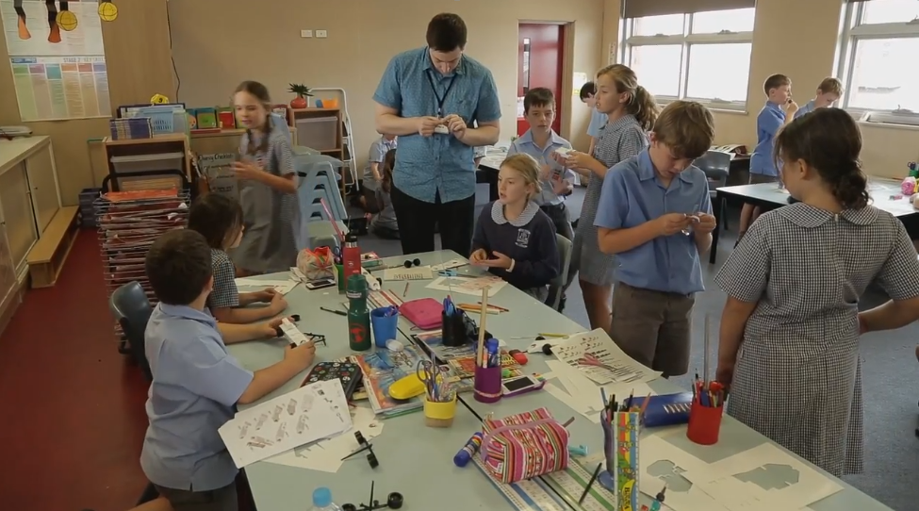
WHEN SHOULD WE INTRODUCE STEM?

Slide 6


Slide 7
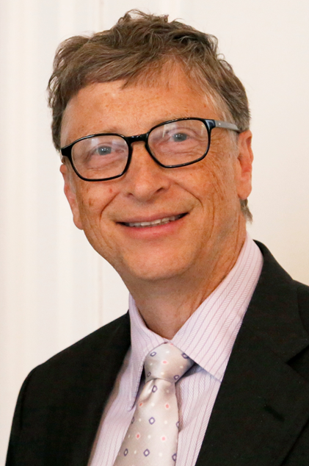
WHY SHOULD WE INTRODUCE STEM?
According to a recent UK Telegraph, article “What degree should you study to become a billionaire?” (25 March 2015).
“Of the world’s wealthiest 100 people, one in four have STEM qualifications – double the number with business degrees; and three times the number of economists.”

Slide 8
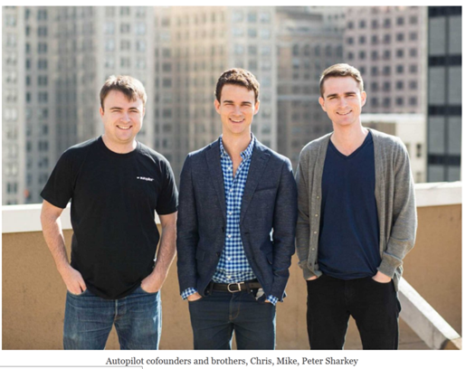
WHY SHOULD WE INTRODUCE STEM?
Chris, Mike & Peter Sharkey
Chris Sharkey a former student of MGHS developed a website called ‘STAYZ’ which he sold to Fairfax for $16 Million when he was 19. Fairfax sold for $US220 Million
Three brothers from MGHS teamed up, moved to the US after receiving a start-up grant. Established a company called ‘Bilsr’ now known as ‘AutoPilot’. Highly successful, value unknown! (100 million+)

Slide 9
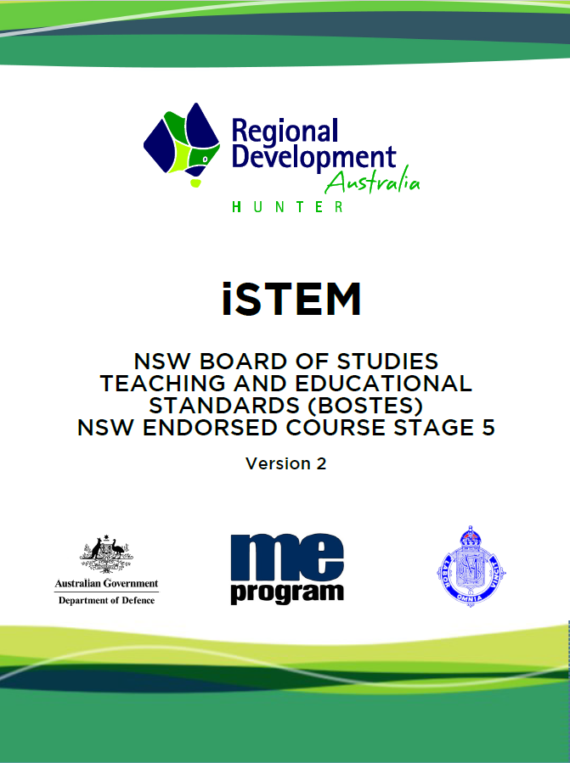






Integrated STEM
iSTEM – School Developed Board Endorsed Course
iSTEM developed in Partnership
105 Schools Currently Endorsed
A third of all iSTEM Schools are in the Hunter
ISTEM will be Delivered by Some of NSW’s top STEM Schools
11% all girls schools
Notes:
iSTEM – School Developed Board Endorsed Course
iSTEM developed through the ME Program, Partner Industries and STEM teachers at Maitland Grossmann High School
Schools endorsed to run ME Program’s iSTEM course has reached 75 and is expected to rise to over 100 in 2017
Currently a third of all iSTEM schools are here in the Hunter
ISTEM will be delivered by some of NSW’s top STEM Schools, including New England Girls School, Parramatta Marist Brothers, Cherrybrook Technology High, Maitland Grossmann High School, Kinross Wolaroi, MacKillop College, Hunter Valley Grammar School, etc.
The outcomes of the ME Program have been outstanding in regards to its ability to increase the number of students taking up STEM subjects in the senior school. However, to really make a difference in the Hunter and NSW we need to have more students involved. Through our iSTEM program we will have over 2000 students actively involved in a school based STEM subjects in 2017 and close to 4000 by 2018. This will led to further increases in STEM participation on a scale which could have a huge impact to the local workforce.
At Maitland Grossmann High School 50% participation by girls in their iSTEM classes is bucking the trend of falling participation by girls in STEM subjects and is breaking down stereotypes

Slide 10

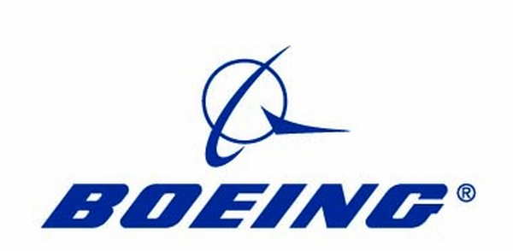



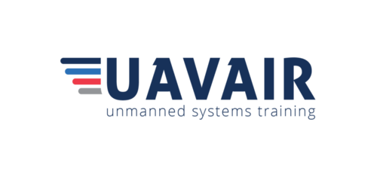















INDUSRTY PARTNERSHIPS

Slide 11
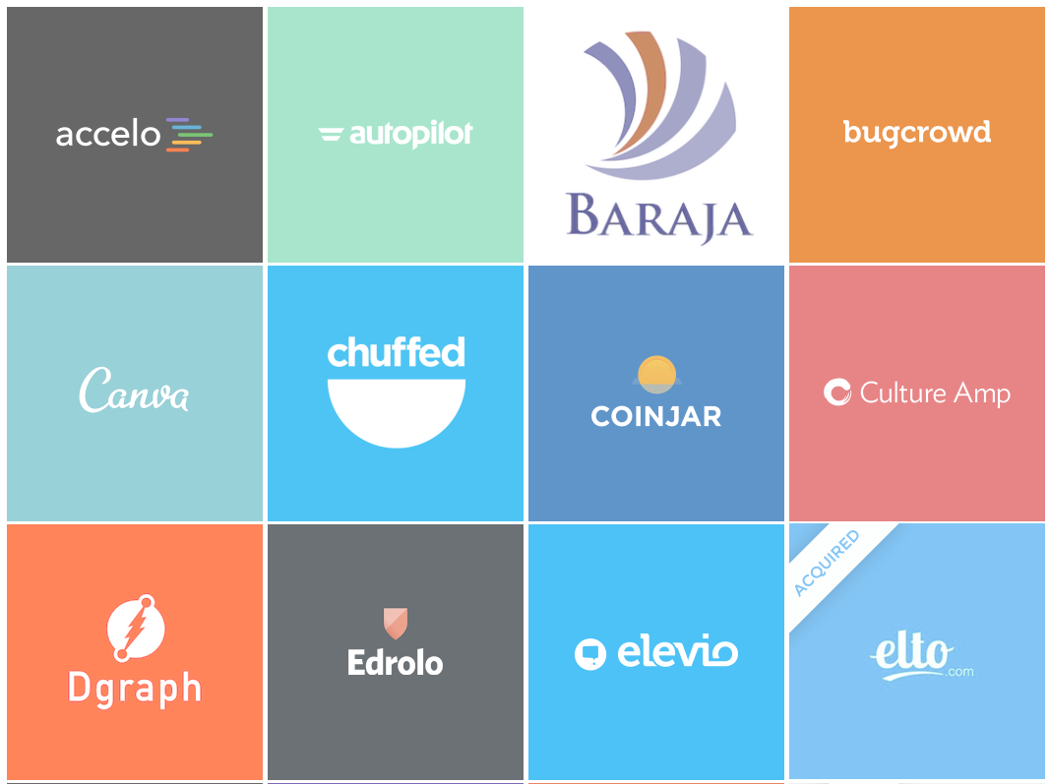


Slide 12
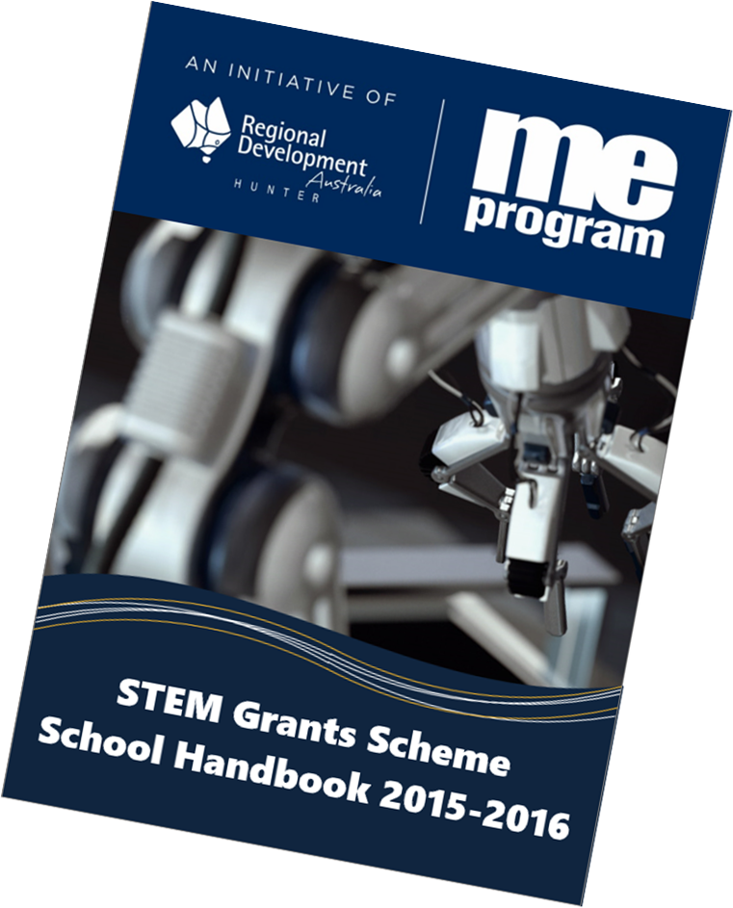
ME PROGRAM STEM GRANTS
42 ME Program School have benefited from;
Over 100 EV3 Lego Robots in Schools. Overall investment in Lego in excess of $200,000 (6 Years)
$40,000 for STEM equipment
22 new 3D Printers. $30,000 in iSTEM start-up and maintenance grants
$27,000 to support schools to compete in the Hunter Valley Electric Vehicle Festival
$15,000 for QUBERIDER Design for Space Program
$15,000 for F1 in Schools Program
$10,000 for STELR science kits for schools
$6,500 for Cert III Remote Piloting Course
Notes:
STEM Grants Scheme
Our STEM Grants Scheme provides funds and equipment to schools that provides the tools to engage students in STEM. This funding bridges the gap between the desire to be involved in STEM with the practicalities of how to do it.
The outcome of which allows more students to experience the types of technologies that they would experience in industry and provides students with the ability to develop the technical and non technical STEM skills that are valued by industry.

Slide 13



ME STEM-SHIP PROGRAM
An opportunity for Hunter Region students to train for the Jobs of Tomorrow through a Vocational Education and Training pathway.
Rick Evans | Industry Training Advisor |
Training Services NSW - Department of Industry

Slide 14
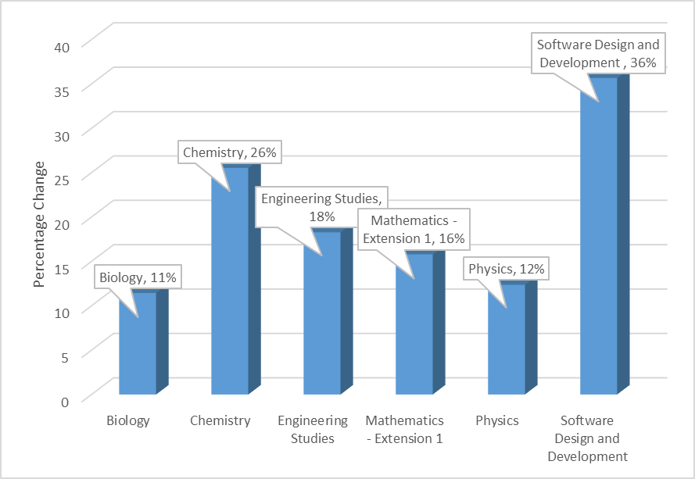
INCREASES IN STEM ENROLEMENT
Notes:
In NSW 12% of HSC Physics students will drop the subject before Year 12, in ME Program Schools this rate is just 6%, a 50% reduction
Metals and Engineering subject selection has risen by 30%
Compared to the NSW average, a student studying at an ME School is three times more likely to study Engineering Studies in their HSC years
St Phillip Christian School recorded a massive 66% increase from 2015 to 2016 in its senior school uptake of STEM subjects after the first graduating iSTEM cohort
West Wallsend will present some outstanding results from the program later this morning

Slide 15
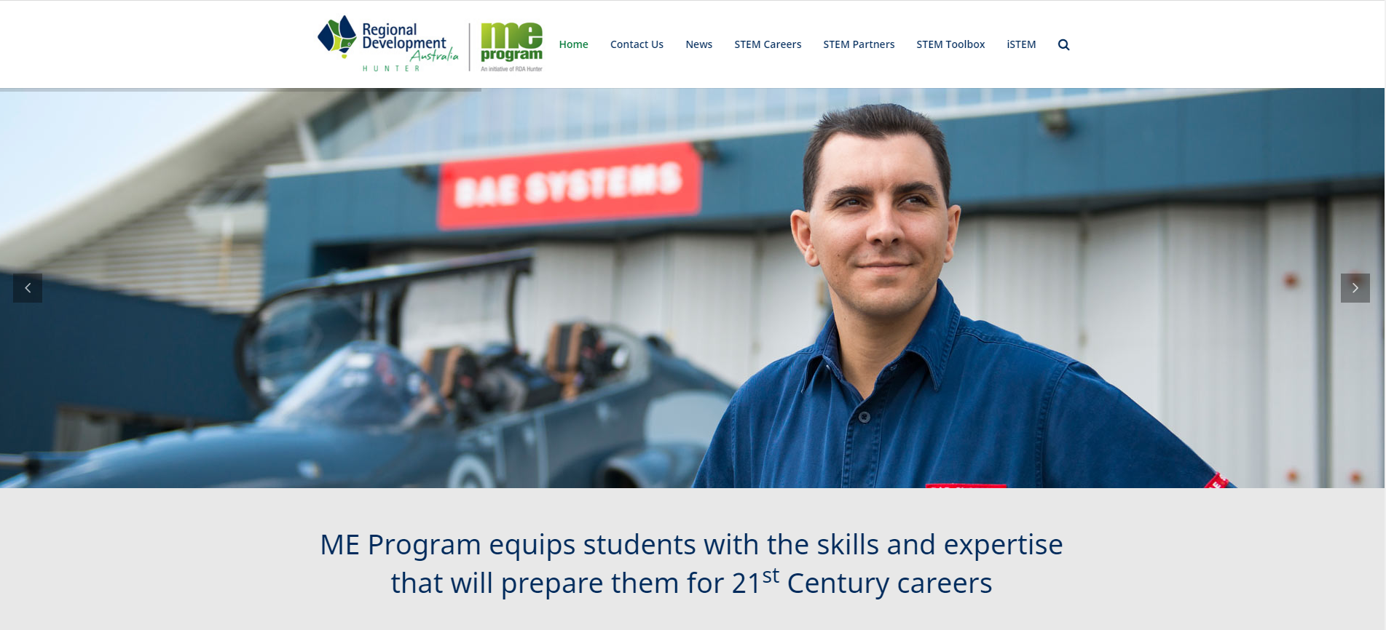
STEM TOOLKIT & WEBSITE
Website: www.meprogram.com.au
Facebook: https://www.facebook.com/MEprogram
Notes:
New ME Program Website
Our new ME Program website hosts our STEM Toolkit resources and our iSTEM page with resources aligned to each iSTEM module. It also has links to STEM based career pages and our partners page is currently being updated.

